Slide 1
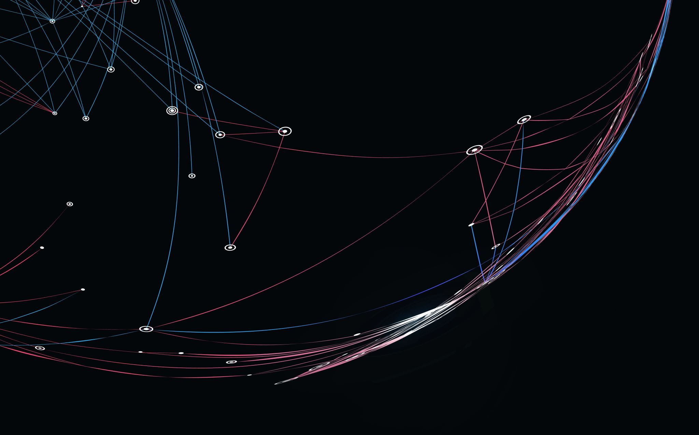
KSU Athletics Data Warehouse
AJ Johnson

Slide 2
Identifying Our Goals
Enhance Student Participation in KSU Athletic Events
Maximize Ticket Revenue Streams
Establish the Foundation for Future KSU Software Initiatives
Foster a Data-Driven Organizational Culture

Slide 3
Business Opportunity
Comprehensive Solution: Offer a one-stop tool for identifying various fan categories.
Efficiency & Automation: Streamline the identification process, saving staff time.
Data Hub: Serve as a stepping stone to a future data warehouse for KSU.
Customizability: In-house development ensures flexibility for department-specific needs.

Slide 4
Business Objectives
Increase Revenue: Systematically identify and target potential ticket purchasers.
Cost Savings: Reduce operational expenses by automating the identification process.
Boost Attendance: Meet and exceed attendance goals as KSU transitions into C-USA.
Insight into Trends: Offer rapid analysis of fan behavior and preferences.

Slide 5
Identifying Our Sources
Identify trends that are both relevant and significant to ticket sales.
Assign a feasibility score to each potential data source to evaluate the ease and practicality of acquiring the data.
Establish a defined schedule for updating the dataset, taking into consideration whether continuous, real-time data retrieval is necessary or if periodic data pulls are sufficient.
Classify data sources based on their relevance and importance. Subsequently, prioritize them in accordance with their potential impact and reliability.

Slide 6
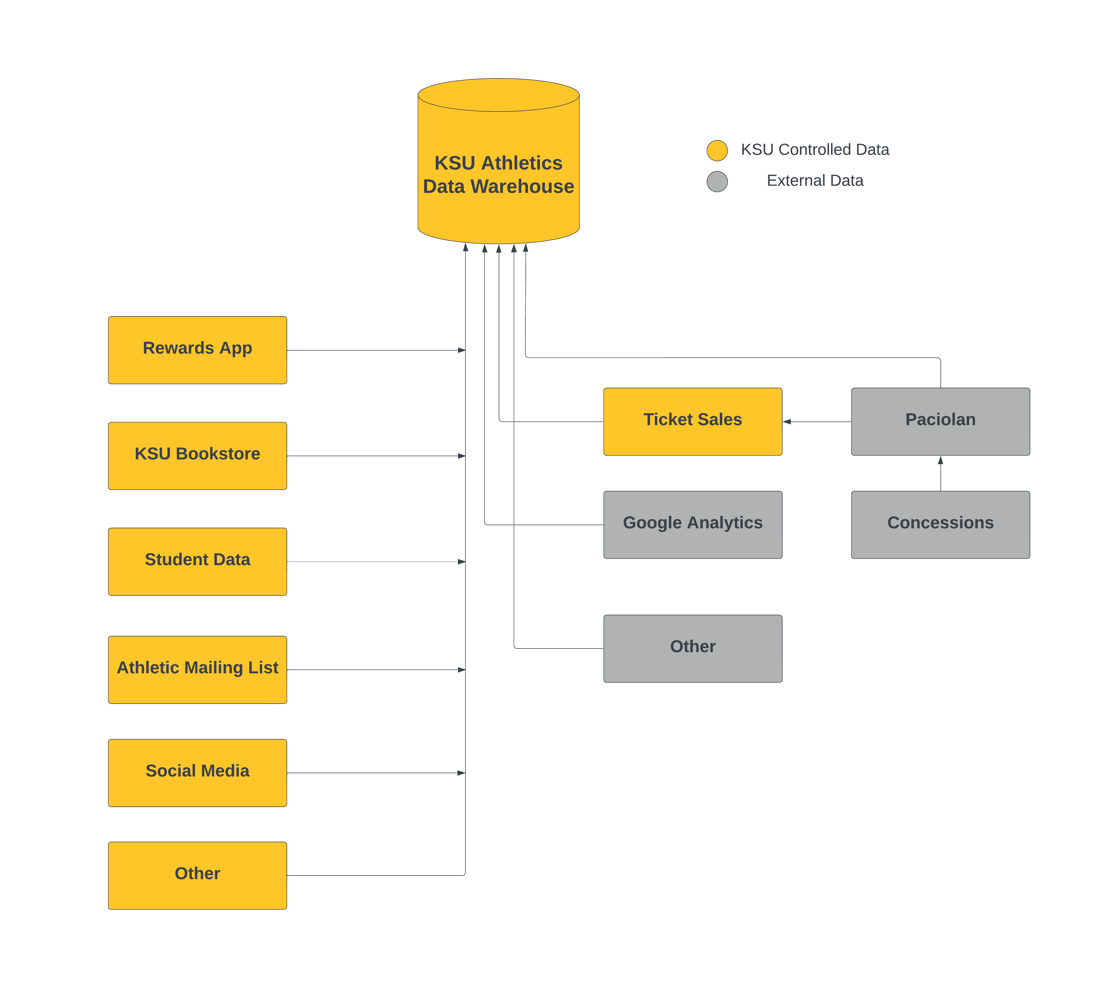
Initial and Potential Data Sources
Internal
External
Architect to expand

Slide 7


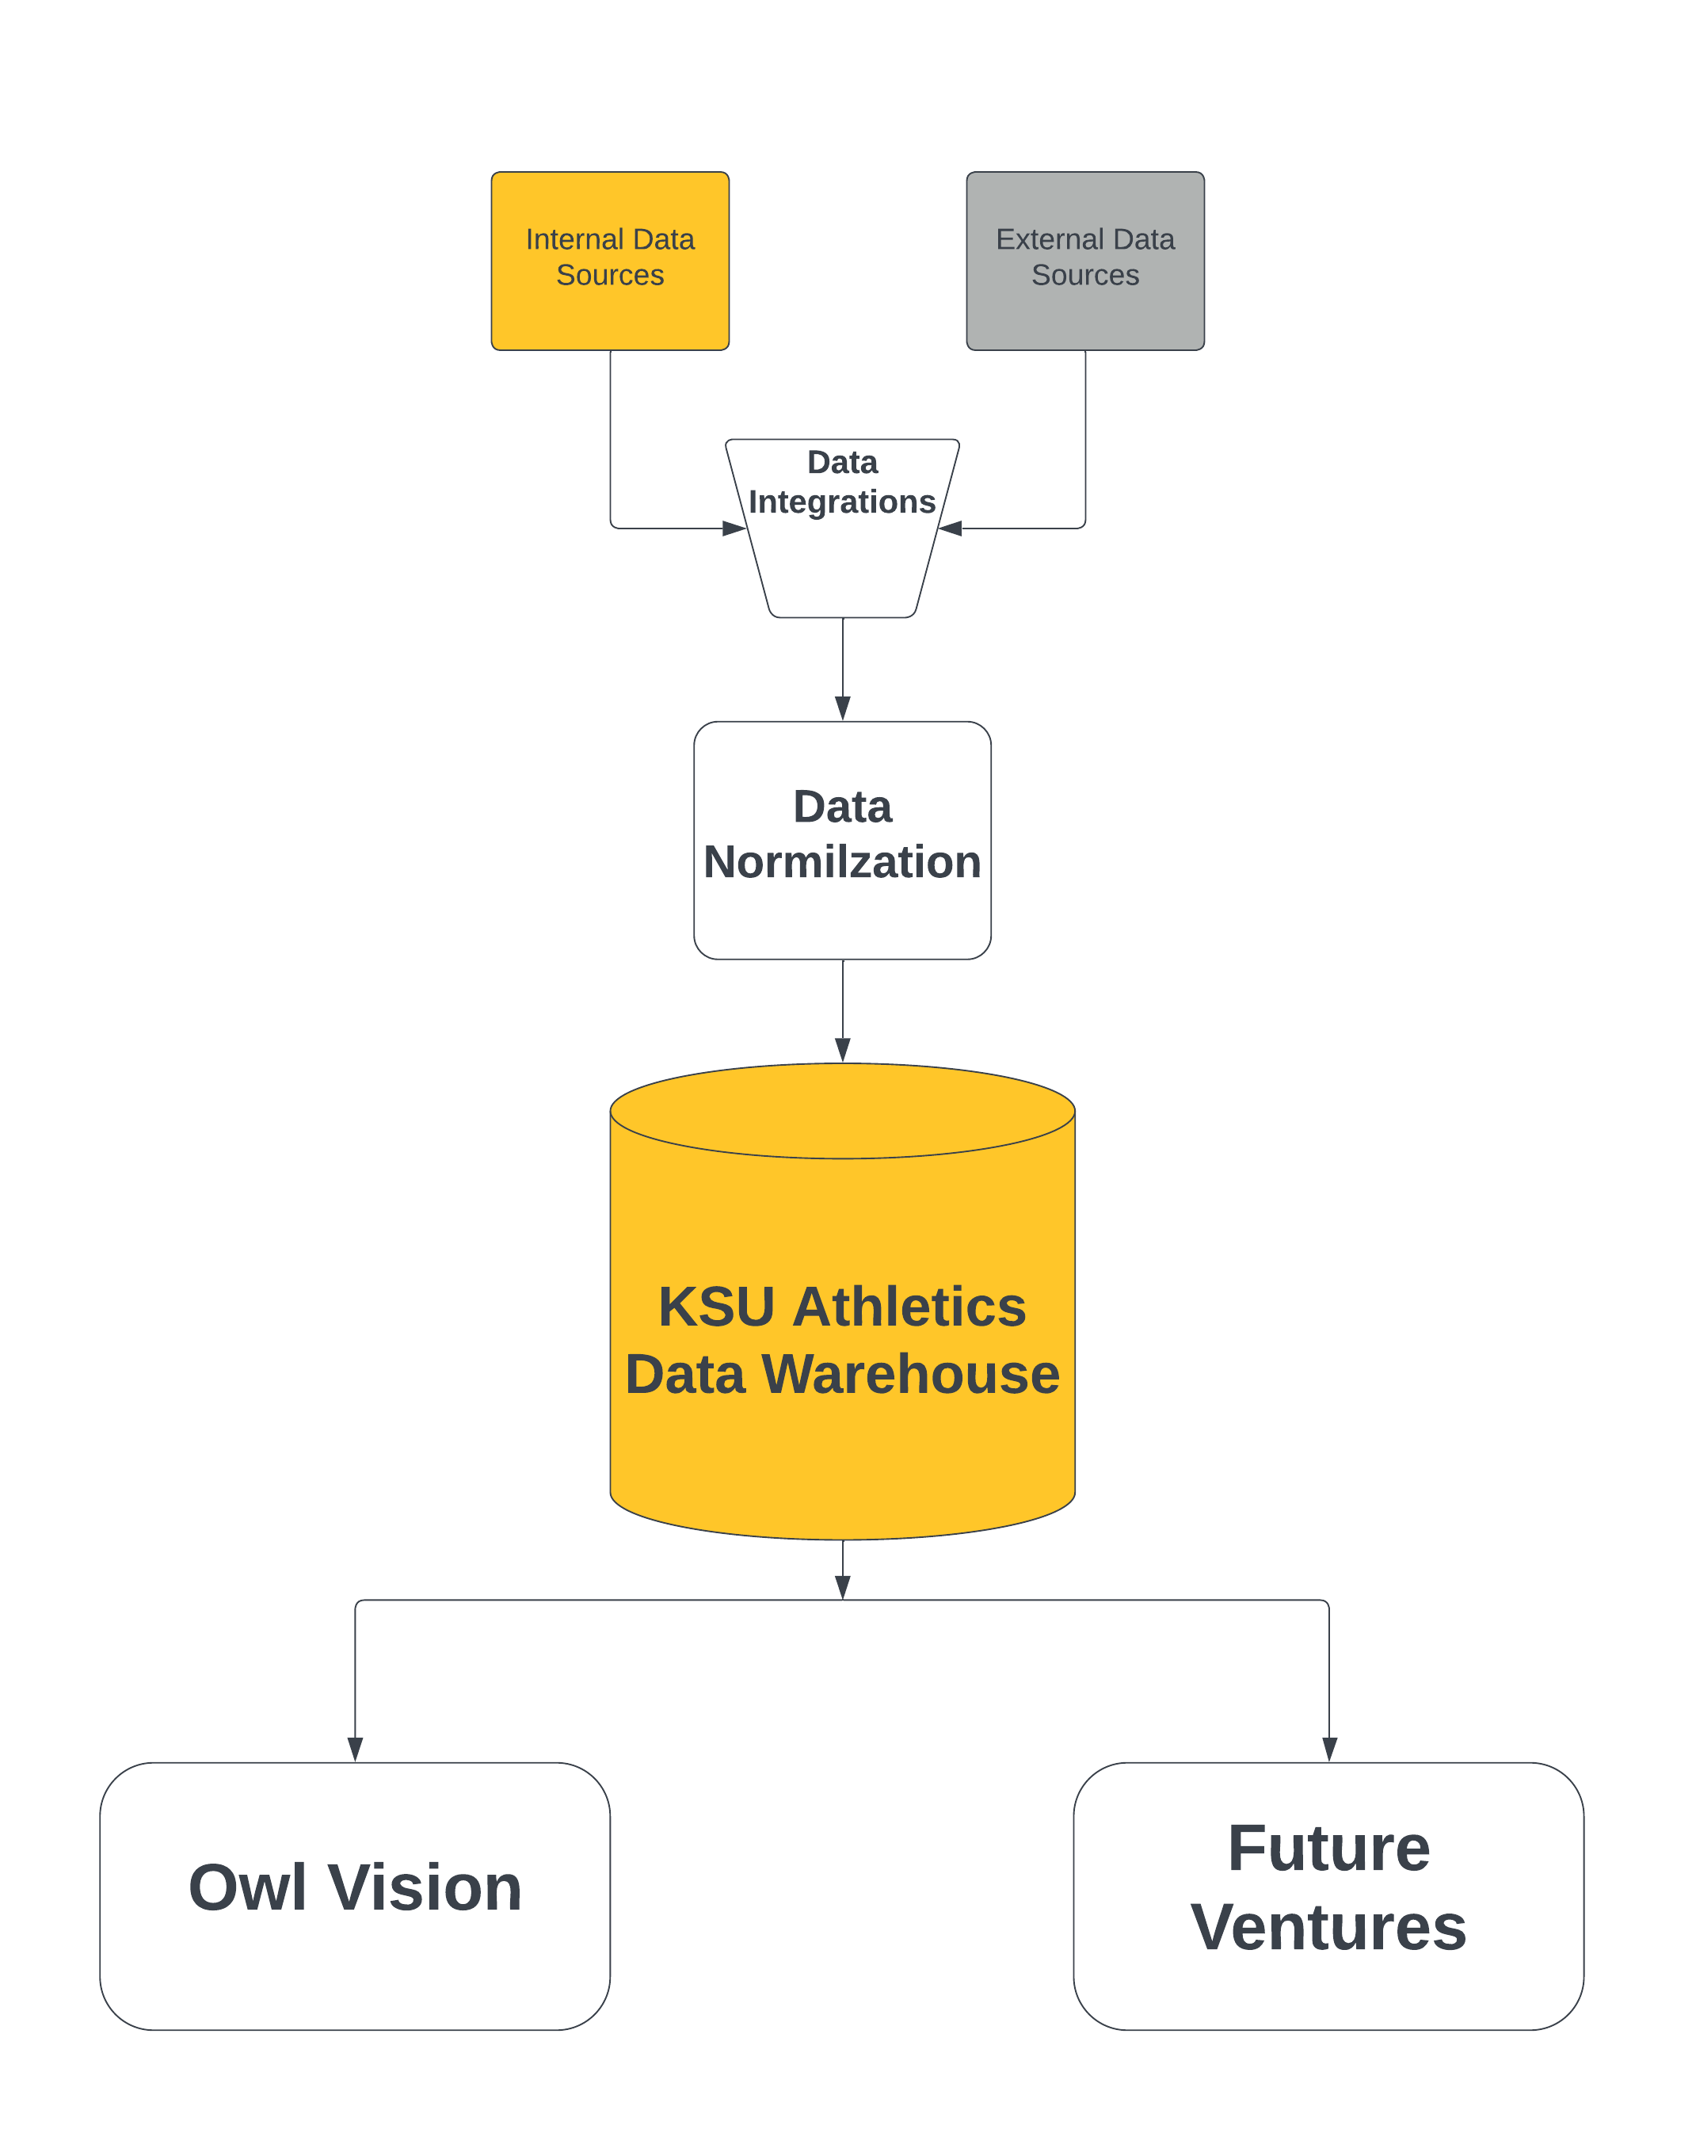
Data Pipeline
Data Sources
Data Normalization
Data Warehouse

Slide 8
How do we accomplish this?
Trend Identification: Recognize initial patterns from persistent data sources for actionable insights.
Infrastructure Development: Construct a sustainable architecture and processes designed for long-term utility and modularity.
User-Centric Design: Develop an intuitive interface that caters to the needs of business users, ensuring smooth integration into existing workflows.
Continuous Improvement: Regularly review and adapt based on feedback, ensuring our system remains relevant and efficient.

Slide 9
Things to Consider
Rules based or Machine Learning Algorithm
Dedicated software for data preparation or built in to Owl Vision

Slide 10
Where do we go from here?
Pinpoint and validate our data origins.
Define and refine our data handling methodologies.
Design and implement a robust, scalable database system.

